Slide 1
Git & GitHub
Initial Commands

Slide 2
Download Git Bash for Windows
Put path of the “bin” & “cmd” file from progamFiles in Environment .
Then open terminal and Run command
git config --global user.name “Your Name"
git config --global user.email yourEmail@gmail.com
Now run command:- git config –list

Slide 3
Basic Git Commands
Git init :- To initialialize the Empty Repository
Git add . :- For adding files in staging area
Git status :- to check the Status of your code
Git commit –m “your Message” :- to commit a change .
Git log :- to track/check your activities. Your commits that your have made before .

Slide 4
Git Commands
(when repo is First time initialized)
Git branch –m main :- To create a Branch in empty repo .
Git remote add origin “link” : To add link of your to your remote Project .
Git push –u origin :- To push your code to GitHub Repo .

Slide 5
Git Status
Untracked file (U):- File that is not added in staging area
Added file(A) :- File that is Added in staging area But Not Commited.
Modified File :- File that is already Commited but made changes after Some time .

Slide 6
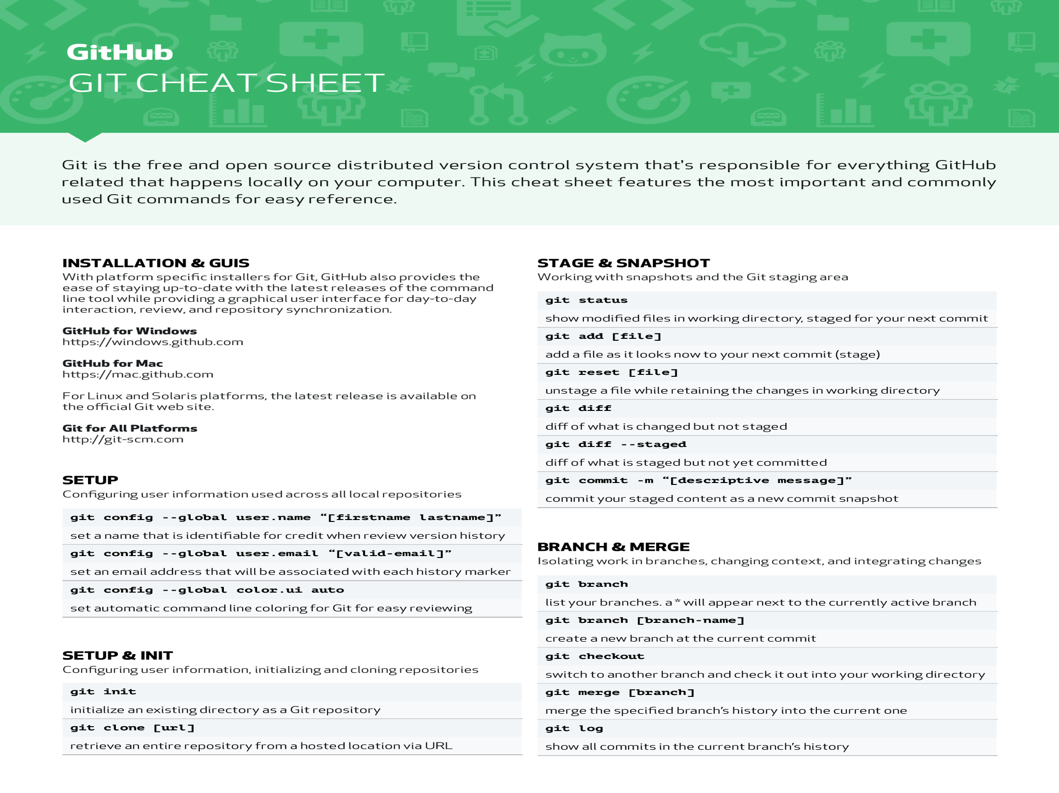

Slide 7
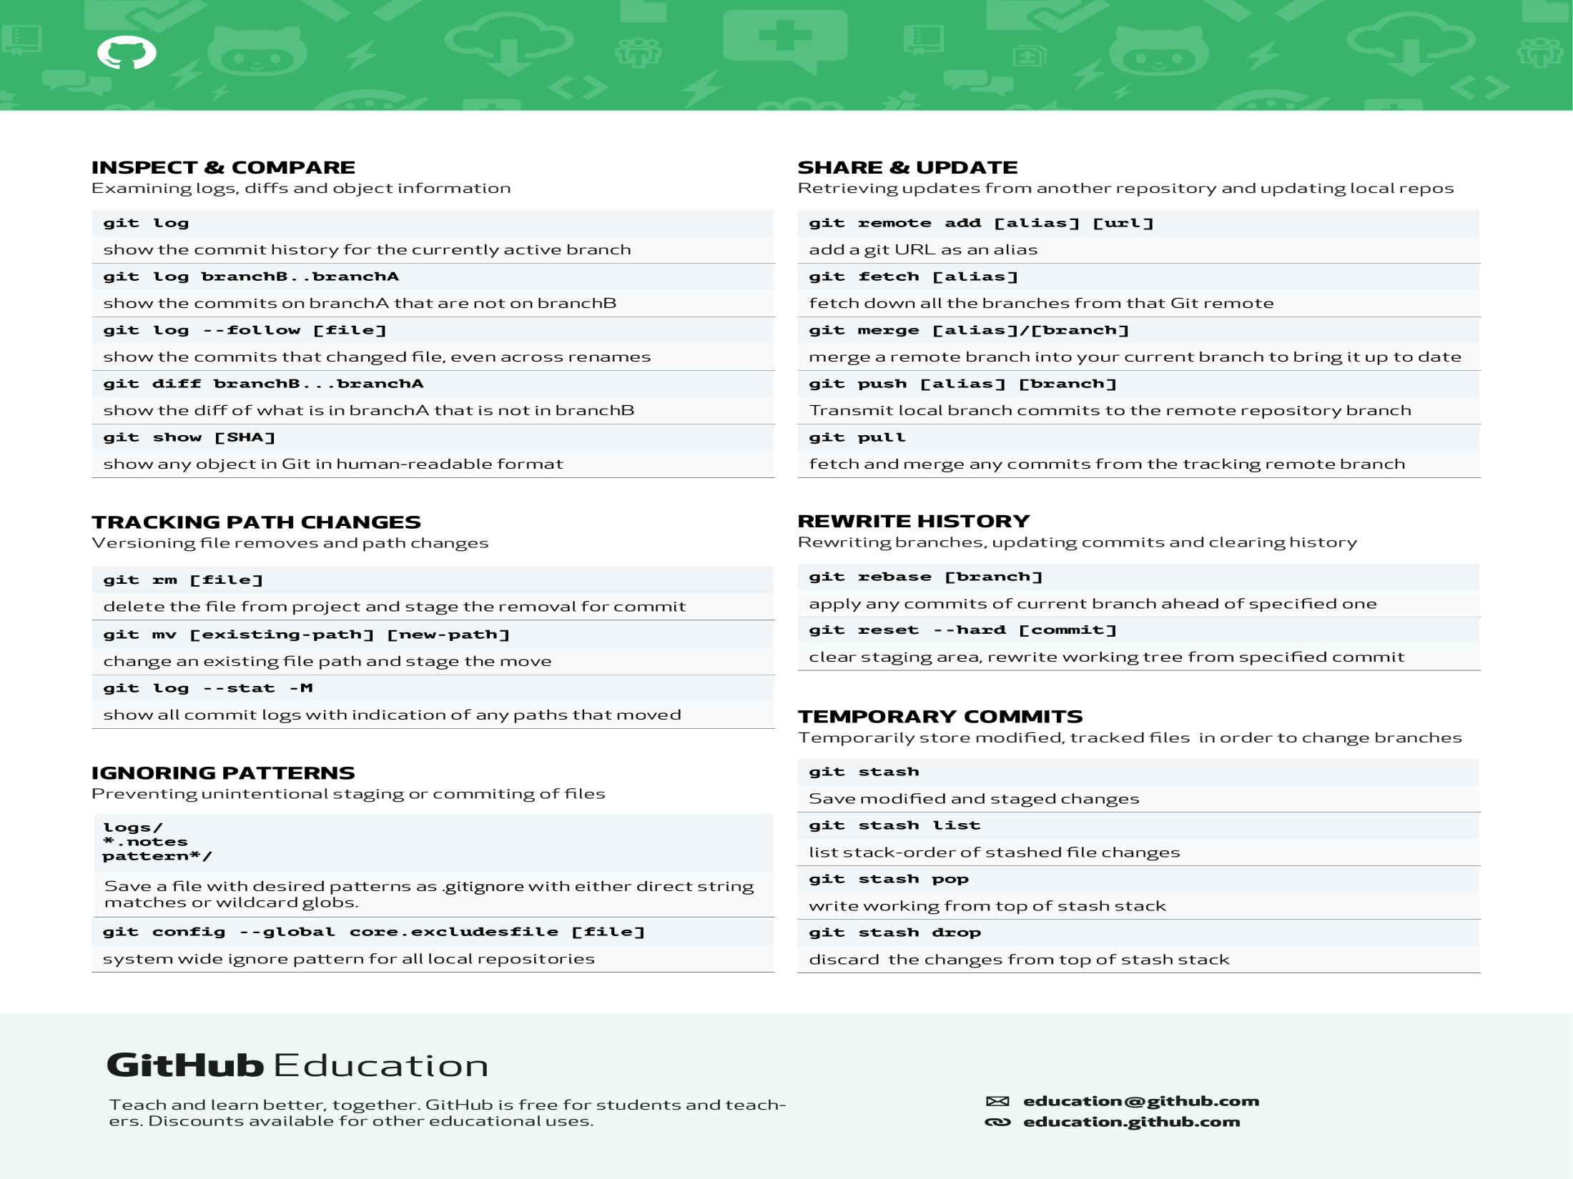

Slide 8
Thank you

